Slide 1
CIS 565 FINAL PROJECT CUDA Feature Matching and Object Tracking Milestone 1 by Yash Vardhan

Slide 2
MILESTONES
Week 1 – Object Tracking on CPU
Week 2 – Object Tracking on GPU and optimizations.
Week 3 – Feature Matching on CPU
Week 4 – Feature Matching on GPU and optimizations.

Slide 3
TRACKING ALGORITHM
Initialization -- Draw a box around the object to be tracked in the initial frame.
Tracking -- Run the tracking algorithm on the object inside the box and the position in next frame and re-draw the box on the new identified position of the object in the new frame.
REPEAT !!

Slide 4
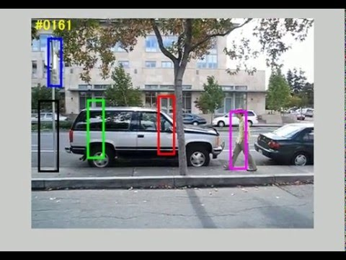
Tracking Algorithms
 | ALGO
 | BOOSTING
 | MIL
 | MEDIANFLOW
 | TLD
 | KCF

Slide 5
CPU IMPLEMENTATION
Used OpenCV’s tracking.hpp – tracker = TrackerKCF::create(); // KCF !! Rect2d to draw box.
Inserted Timer function to analyze each step in the tracking package of openCV using – clock_t
All tests were performed on Chaplin video (1280 x 720) on Intel Core i5 4200U 2.6Ghz

Slide 6
Analysis of each step
STEP | MOST TIME-TAKING SUBSTEP | TIME FOR SUBSTEP (ms) | OVERALL STEP TIME (ms)
Detection | Compute Gaussian Kernel | 20.1 | 47.5
Descriptor Matrices Calculation | Discrete Fourier Transform | 7.3 | 14.6
Updating Input Features | Principal Component Analysis | 20.2 | 25.2
Linear Regression | Gradient computation | 18.6 | 22.6
TOTAL |  |  | 109.9

Slide 7
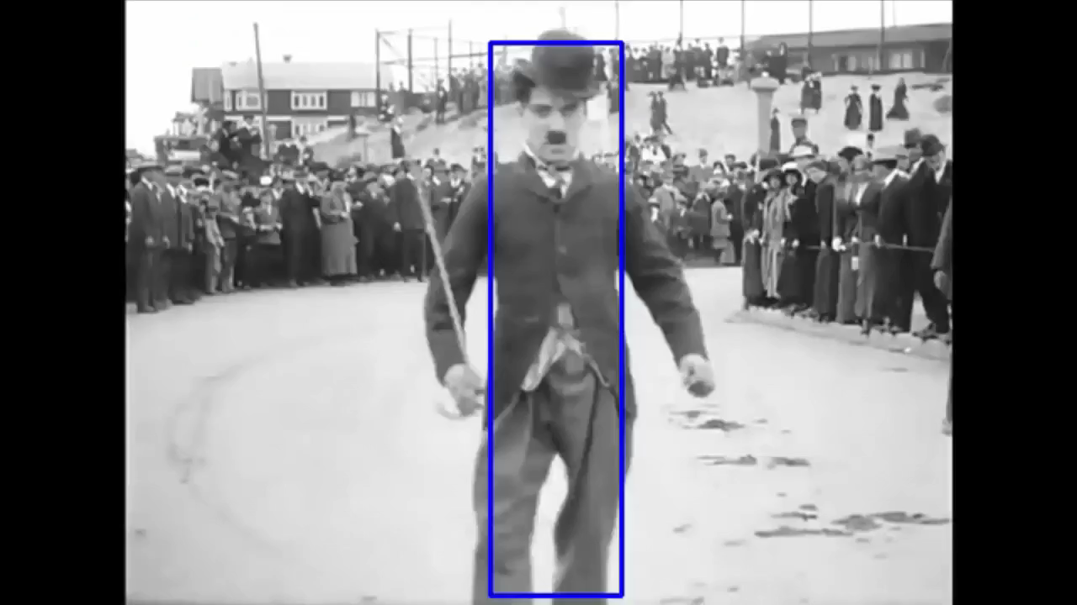
RESULT

Slide 8
NEXT WEEK
OBJECT TRACKING ON GPUs – Ideas
Replace the DFT calculation with FFT(maybe use CuFFT).
Call kernels !!

